Slide 1
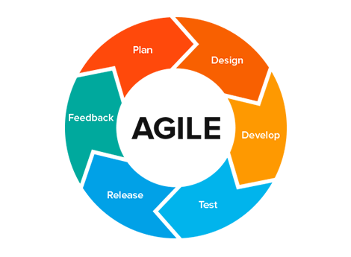
What is Agile Methodology
Agile Methodology emphasizes on four core values:
Individual and team interactions over processes and tools.
Working software over comprehensive documentation.
Customer collaboration over contract negotiation.
Responding to change over following a plan.
Agile Methodology

Slide 2

SCRUM
Scrum is an agile development method which concentrates specifically on how to manage tasks within a team-based development environment.
It is designed for teams of three to nine members, who break their work into actions that can be completed within time boxed iterations, called sprints.
Scrum scheduling

Slide 3

SCRUM MASTER
Scrum Master is responsible for setting up the team, sprint meeting and removes obstacles to progress.
The scrum master is not a traditional team lead or project manager but acts as a buffer between the team and any distracting influences.
The core responsibilities of a scrum master include
Coaching the team in order to deliver high-quality features for its product.
Facilitating team events to ensure regular progress.
Promoting self-organization and cross-functionality within the team.
Role of Scrum Master

Slide 4
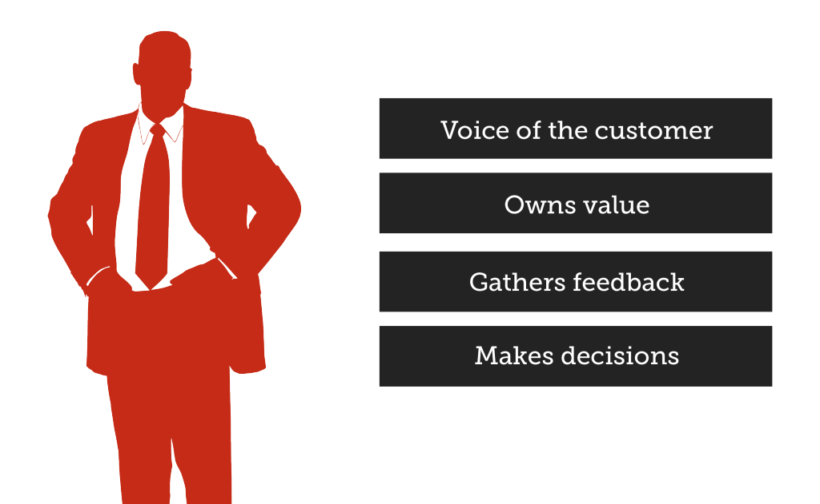
PRODUCT OWNER
The Product Owner creates product backlog, prioritizes the backlog and is responsible for the delivery of the functionality at each iteration.
A scrum team should have only one product owner
Some tasks of product owner include
organize further meetings to demonstrate the solution to key stakeholders
communicates delivery and team status
negotiates priorities, scope, funding, and schedule
Role of Product Owner

Slide 5
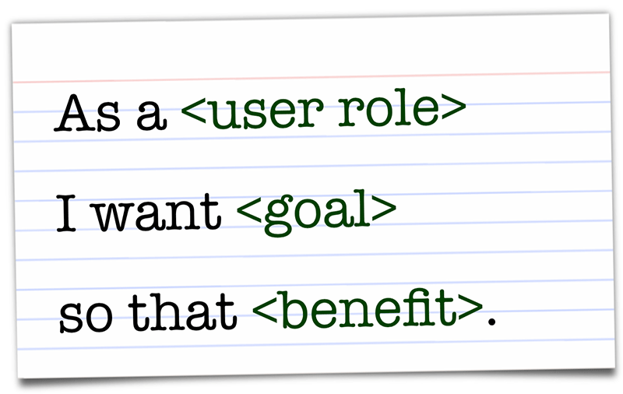

USER STORIES
User stories are one of the primary development artifacts for Scrum.
User story is simply something a user wants.
User stories represent customer requirements in a card leading to conversation and confirmation.
Template of User Story
As a <type of user>, I can <some goal> so that <some reason>
User Stories

Slide 6
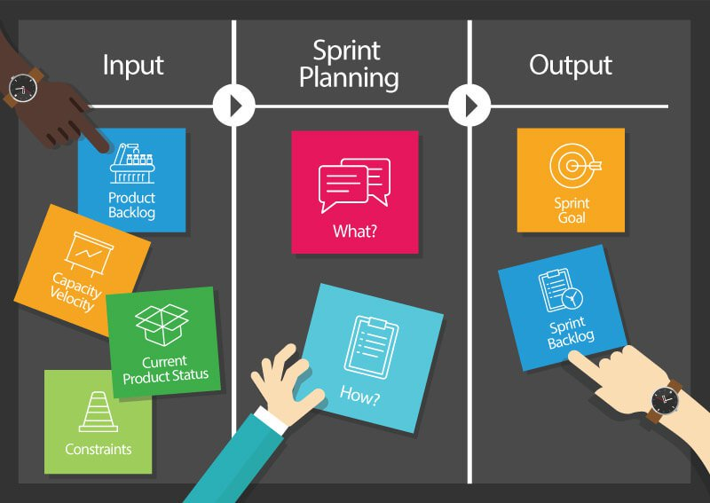
Sprint Planning
A Sprint team holds a Sprint planning to:
Mutually discuss and agree on the scope of work that is intended to be done during that sprint.
Select product backlog items that can be completed in one sprint.
The recommended duration is four hours for a two-week sprint.
Once the development team has prepared their sprint backlog, they forecast (usually by voting) which tasks will be delivered within the sprint.
Sprint Planning

